Slide 1
Seasonal Trends in Pharmaceutical Sales
Tristan Morlock, Edgar A Rivera, Cory D Vanderpoel, & Jess Chalker

Slide 2



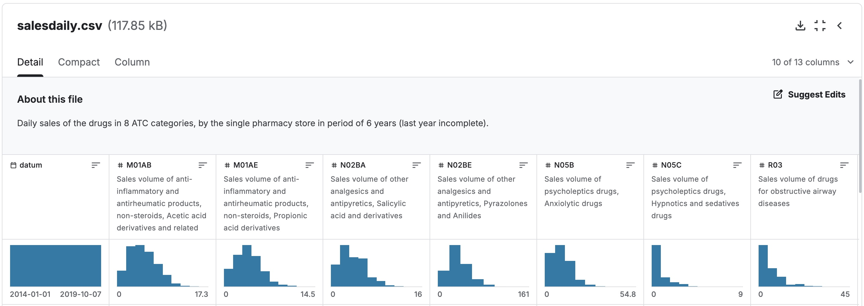

Project Overview
Objective
To explore seasonal sales trends in pharmaceutical drug categories.
Why this matters
Inventory planning, marketing, & healthcare availability.
Fig. 1: Overview of the Data

Slide 3
Dataset Summary
Pharma sales data
Time-Series
Our Approach
Daily sales of the drugs in 8 ATC categories,
Built from the initial dataset consisted of 600000 transactional data collected in 6 years (period 2014-2019)​
The data is broken down into four time-series captures:
  Hourly
  Daily
  Weekly
  Monthly
Typically, a time-series data embodies each of the four different components:
level (mean of time-series data);
trend (long-term increasing or decreasing value in series);
seasonality (the repeating short-term cycle in the series); and
noise or residuals (random variations in the series)
The methodology for implementing this case study follows the typical time series forecasting pipeline, consisting of three major phases:
feature engineering and data preparation;
exploratory data analysis (time-series analysis);
and forecasting.
For the purposes of our predictive model, we will focus primarily on monthly sales

Slide 4
Drug’s Covered
M01AB: Anti-inflammatory and antirheumatic products, non-steroids, Acetic acid derivatives and related substances​
M01AE: Anti-inflammatory and antirheumatic products, non-steroids, Propionic acid derivatives​
N02BA: Other analgesics and antipyretics, Salicylic acid and derivatives​
N02BE: Other analgesics and antipyretics, Pyrazolones and Anilides​
N05B: Psycholeptics drugs, Anxiolytic drugs​
N05C: Psycholeptics drugs, Hypnotics and sedatives drugs​
R03: Drugs for obstructive airway diseases​
R06: Antihistamines for systemic use​

Slide 5
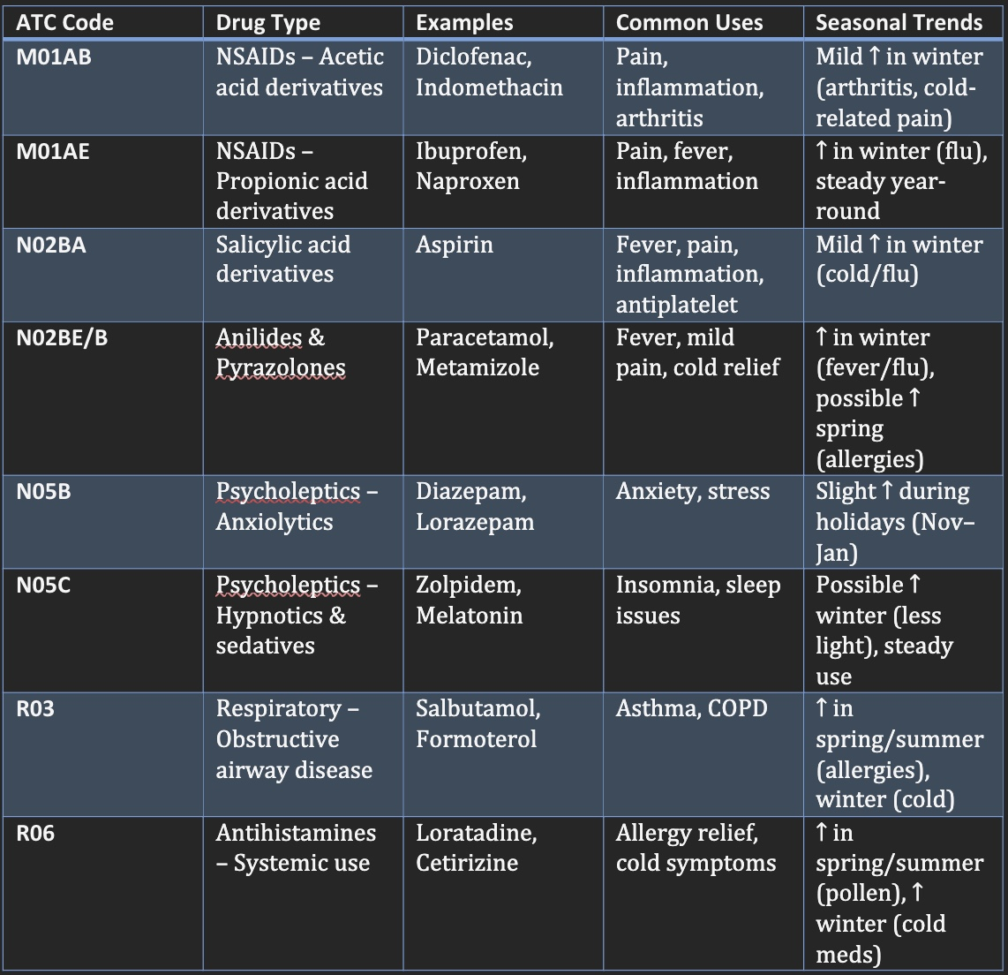
Methodology
& Data Cleaning
Cleaned and sorted the data to identify points of comparisons:
  month,
  seasons,
  years.
Pivoted to long format
Aggregated average monthly sales per season & year
Visualization tools used: ggplot2, dplyr, tidyverse, readxl, forecast, readr
Fig. 2: ATC Drug Categories

Slide 6

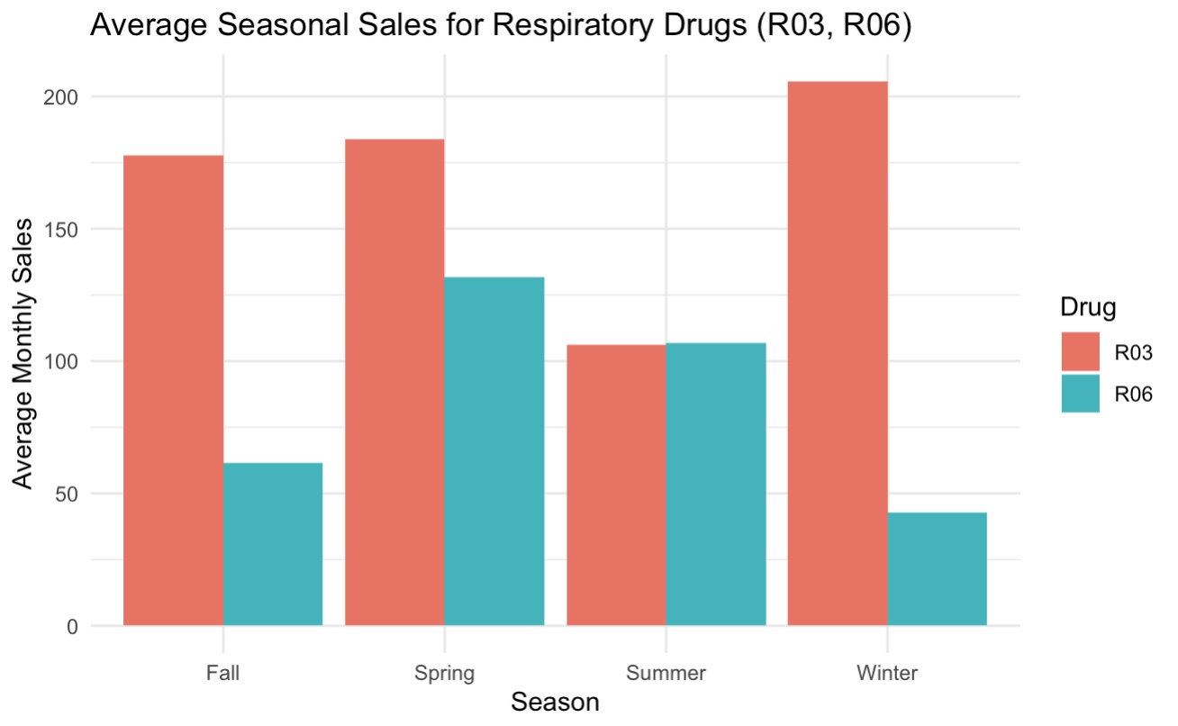
Respiratory / Allergy (R03, R06)
R03 — Respiratory
Highest peak in Winter with steady increase leading in and decrease coming out — notable drop in Summer. Respiratory illness are often agitated by colder weather.
R06 — Allergy
Highest peak in Spring, followed by Summer — suggests potential allergy season trends.
Fig. 3: Seasonal Sales Trends — Respiratory / Allergy

Slide 7
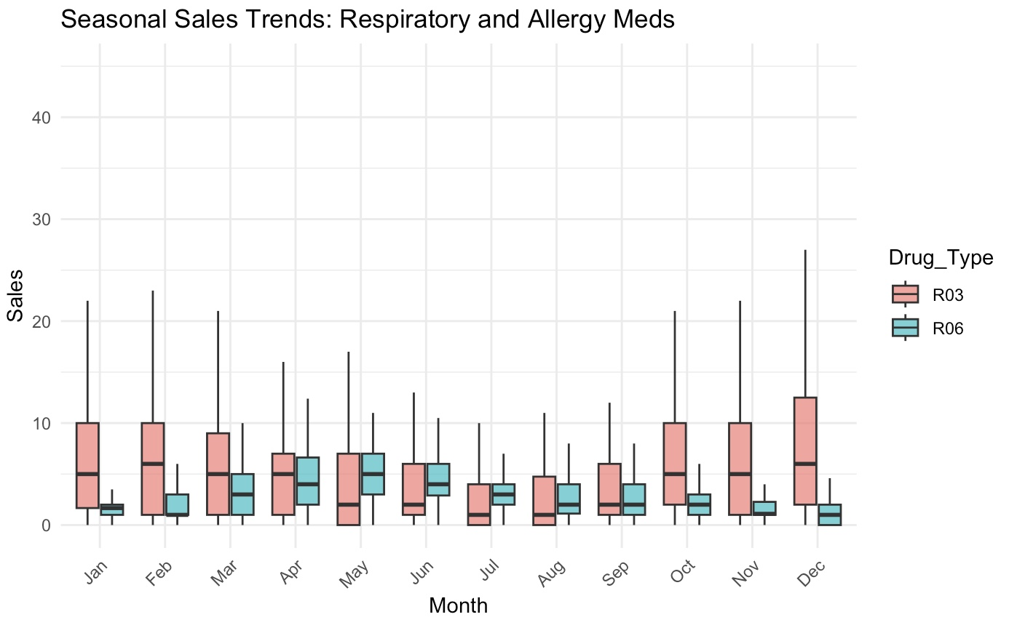
Seasonal Sales Trends: Respiratory and Allergy Meds
Asthma_Drugs:
Higher variability and sales overall.
Peaks in winter and early spring (Dec–Mar), with December showing the highest sales.
Suggests seasonal spikes potentially tied to cold/flu season, winter triggers, or increased respiratory infections.
Allergy_Meds:
More stable, lower median sales throughout the year.
Slight uptick in spring (Mar–May) — potentially aligning with pollen/allergy season.
Sales remain relatively flat compared to asthma drugs.
Interpretation
Asthma medication usage is strongly seasonal, with clear increases during colder months. This could be linked to:
Respiratory infections
Cold-induced asthma exacerbation
Increased indoor allergens (e.g., dust, mold)
Allergy medications show minor seasonal influence, possibly indicating:
More consistent year-round use (chronic allergies)
Mild seasonal variation with a small rise in spring due to environmental allergens like pollen.
Fig. 4: Seasonal Sales Trends II — Respiratory / Allergy

Slide 8
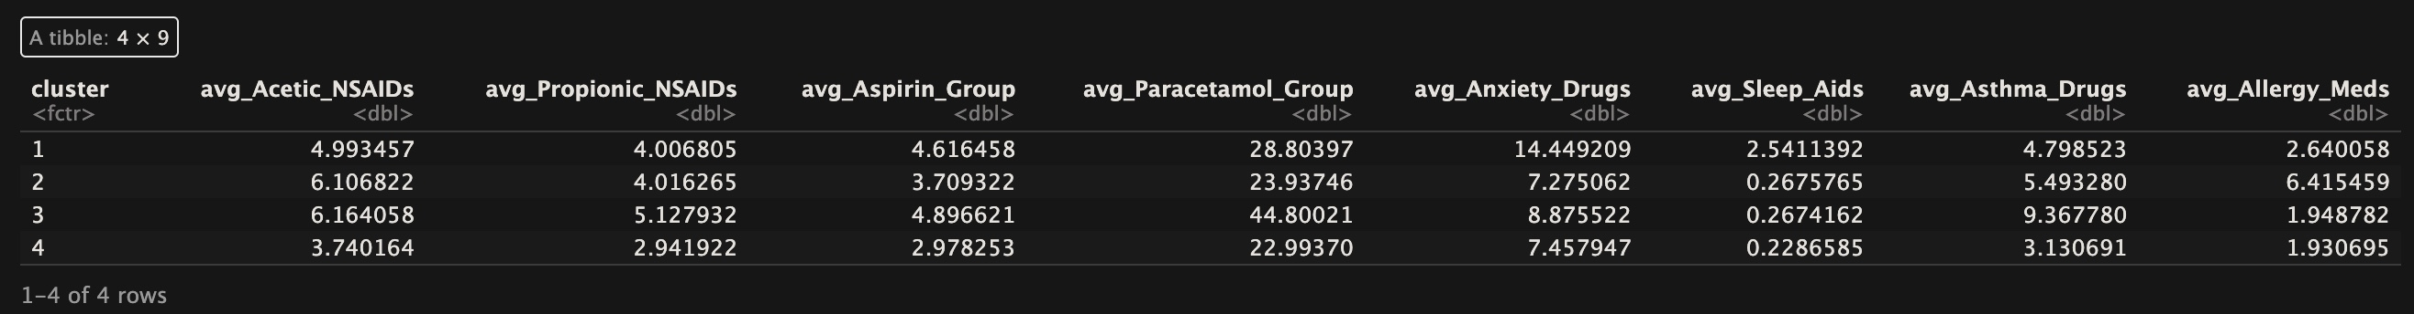
Seasonal Sales Trends: Respiratory and Allergy Meds
Fig. 5: Cluster Averages
Cluster: High Flu Season Days
Paracetamol_Group has the highest average → Suggests cold/flu symptom treatment.
Asthma_Drugs are also elevated → Flu can worsen asthma.
Interpretation: Likely January–March. Respiratory illness peaks. OTC cold remedies dominate.
Cluster: Mental Health Days
Anxiety_Drugs and Sleep_Aids are the highest here.
Pain meds like NSAIDs or Paracetamol are lower.
Interpretation: Possibly stress-related spikes (e.g., late-year holidays or post-summer adjustment periods).
Cluster: Baseline/Low Sales
Most drug groups have their lowest averages.
Interpretation: Quiet months like summer (June–August), with minimal illness and fewer prescriptions.
Cluster: Steady Pain Relief
Aspirin, NSAIDs, and Paracetamol show consistent, mid-level averages.
Interpretation: Reflects days where pain and chronic condition management dominate.

Slide 9
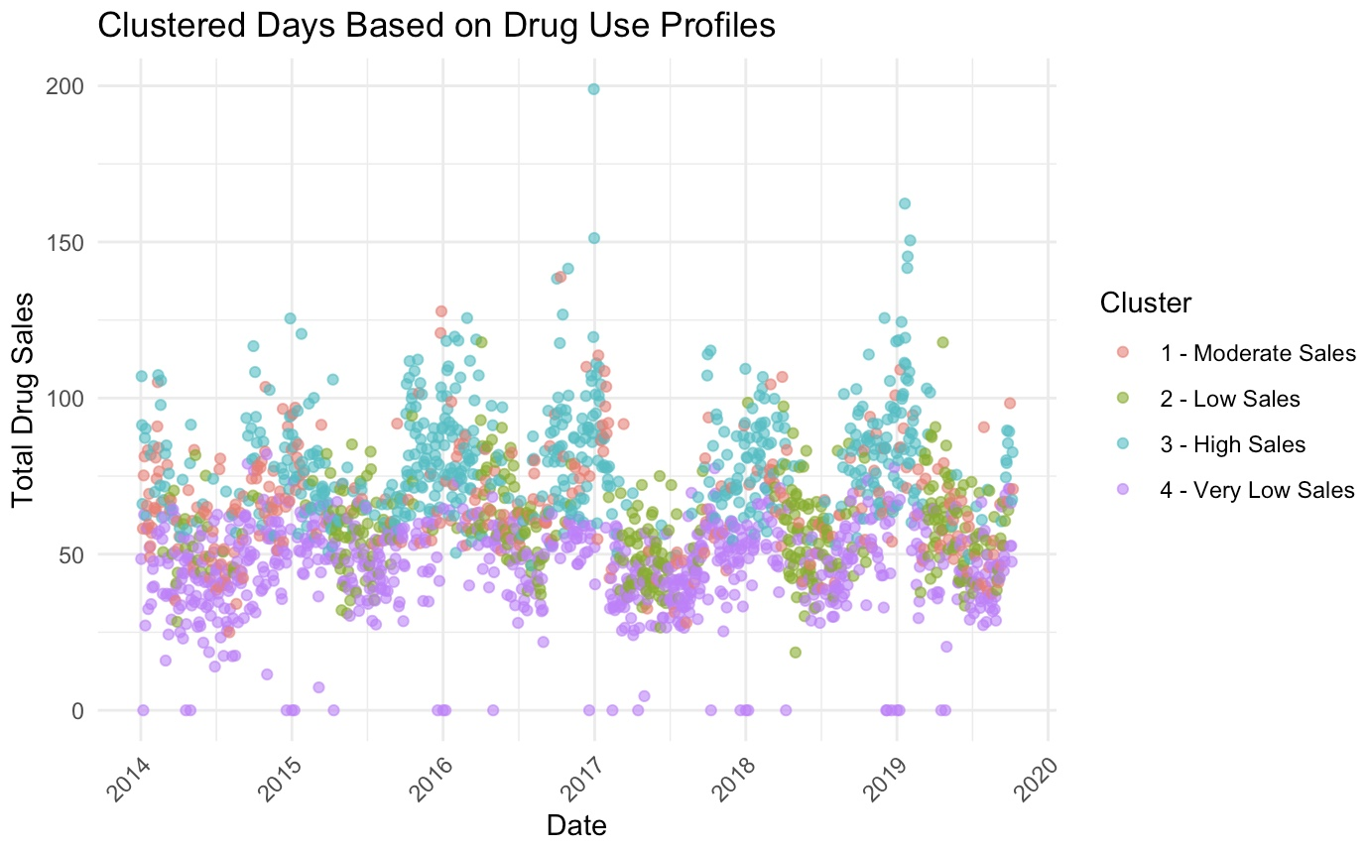
Seasonal Sales Trends: Respiratory and Allergy Meds
Fig. 17: Cluster Map

Slide 10
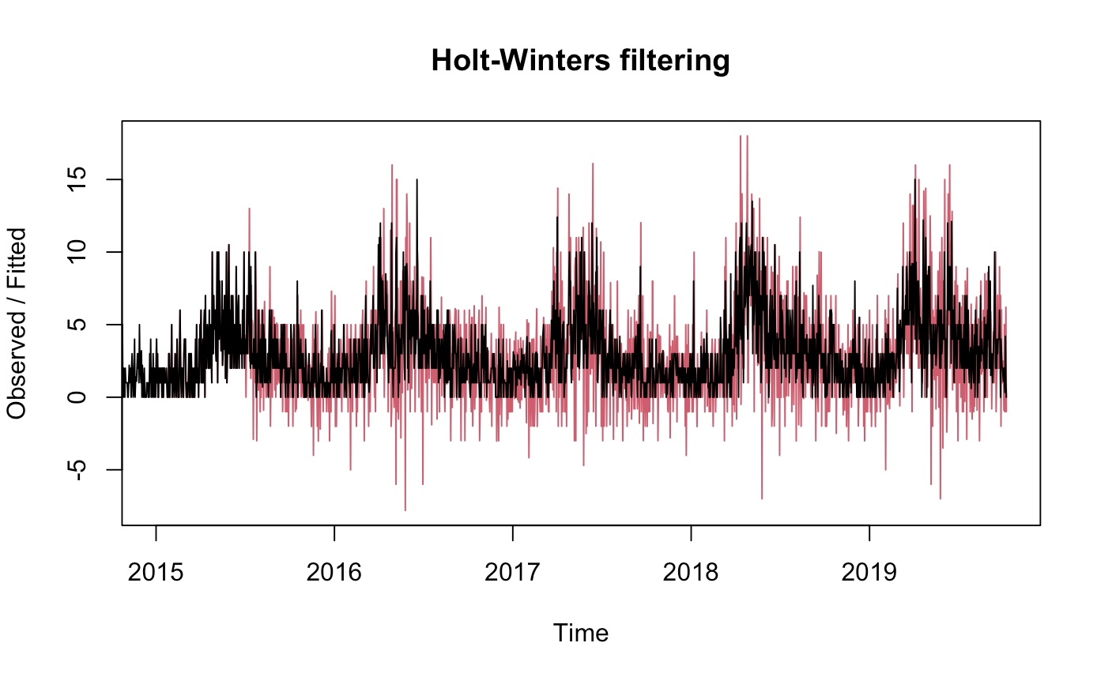
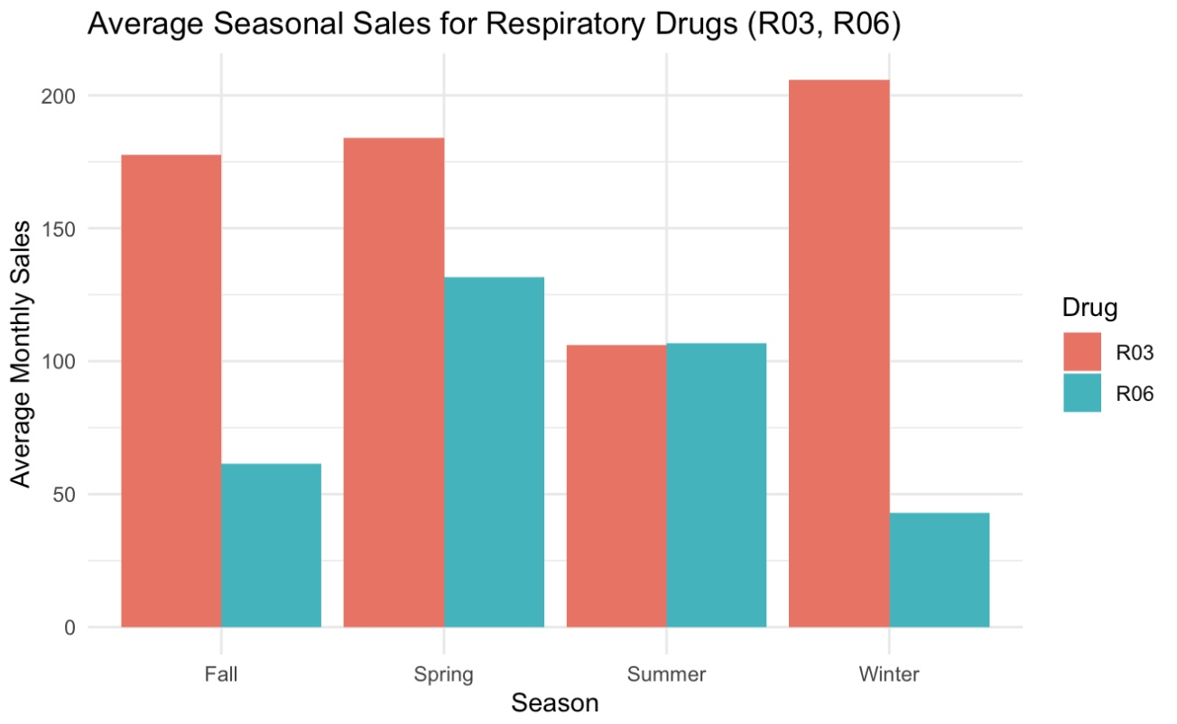
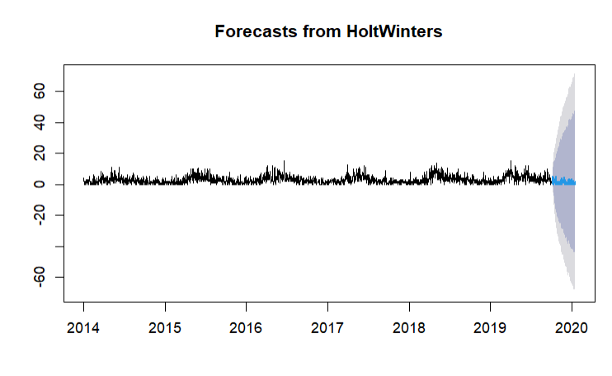
Forecasting with Holt-Winters Method
R06 is a respiratory/allergen variable. This would make sense with seasonal repetition, since seasonal allergies are a massive problem for many people in the US.
Adjusted the Beta and Gamma values to be appropriate for not having a general trend and including seasonality.
Forecasts the next 100 days of R06 sales
Fig. 6: Holt-Winters Filtering
Fig. 7: Holt-Winters Prediction

Slide 11
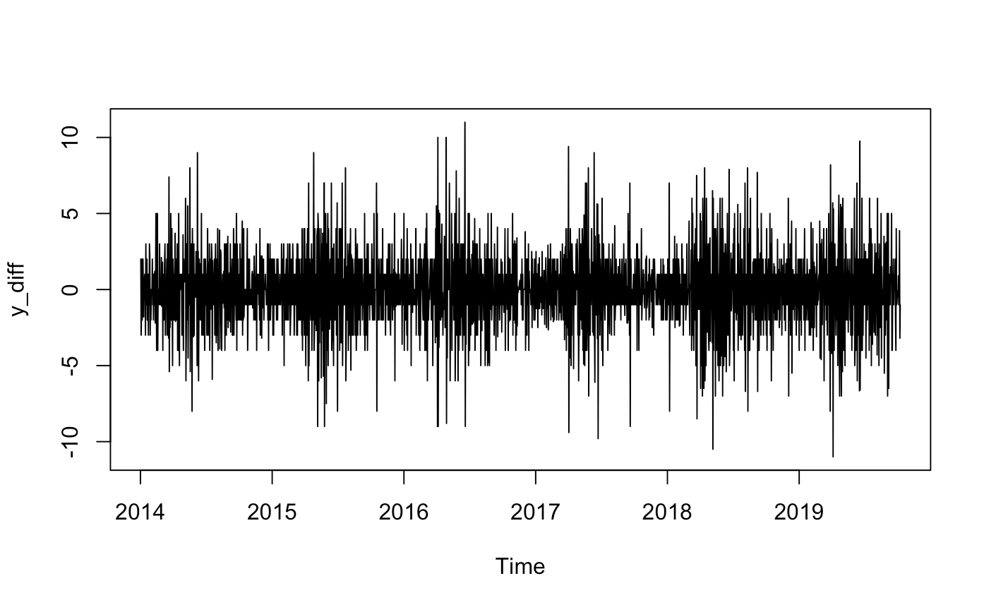
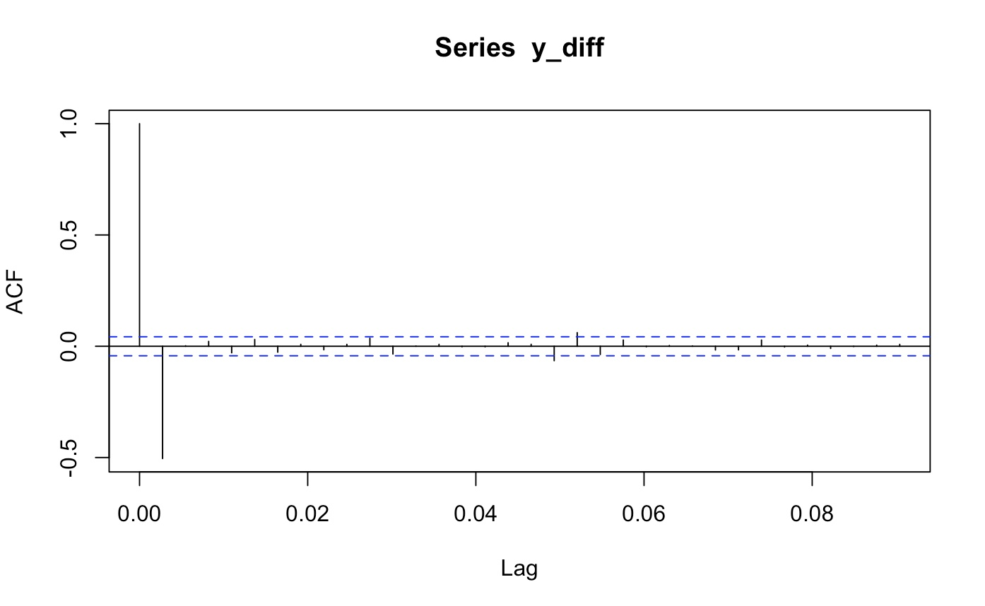
ARIMA Analysis
This is the first difference of the original time series
No obvious upward or downward trend
ACF = Autocorrelation Function: measures how correlated the time series is with its past values (lags).
Fig. 8: ARIMA Analysis
Fig. 9: ACF Time Series Analysis

Slide 12
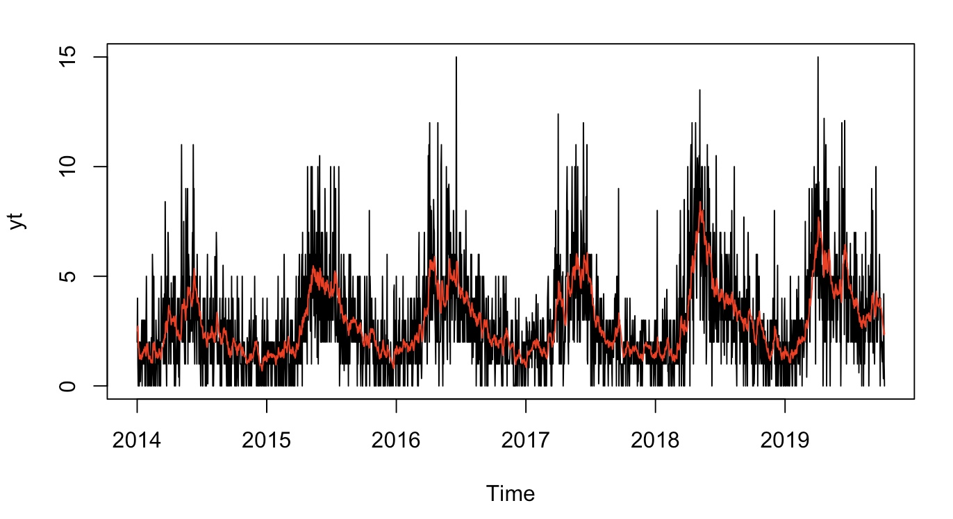
ARIMA Analysis Cont’d.
The black line is the actual daily sales for R06
The red line represents the model’s fitted values: this is the original data minus the model’s residuals, i.e., how well the MA(1) model captures the trend in the differenced series and projects it back onto the original scale.
Fig. 10: ARIMA Trend Difference Analysis

Slide 13
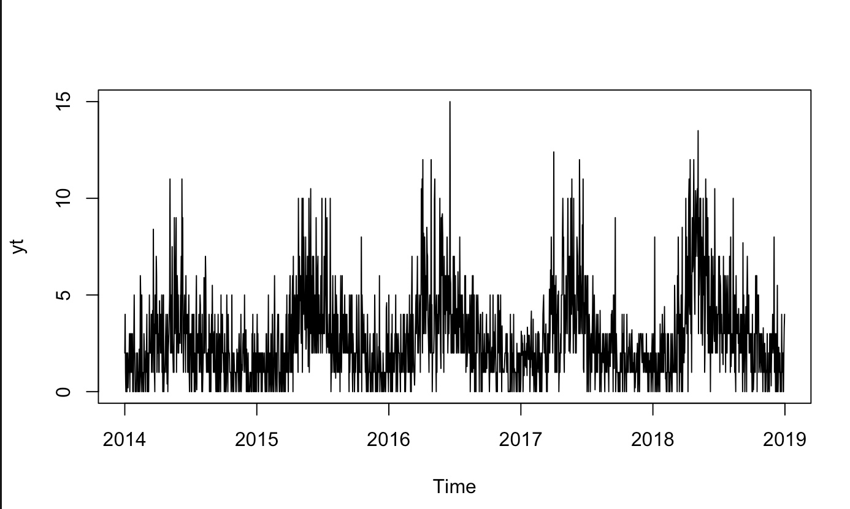
Training and Validation
Sectioning off the final year of the data set to compare to the HoltWinters Forecast to show how accurate the model is.
Fig. 17: Training of the Model

Slide 14
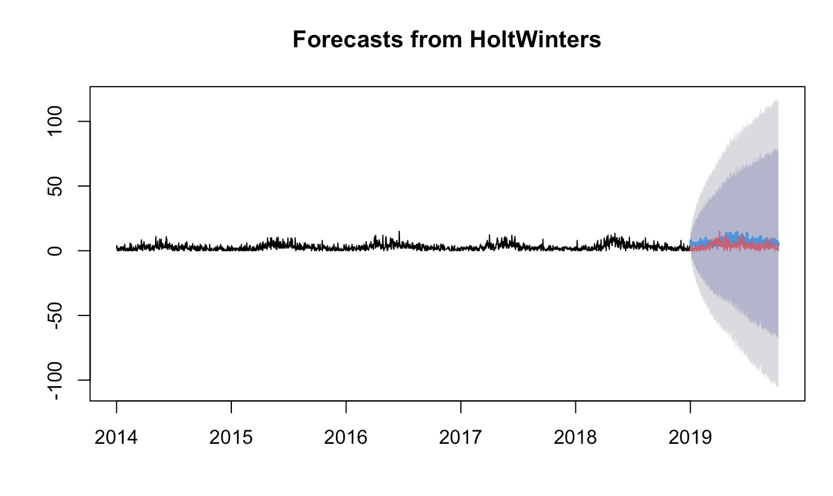
HoltWinters –
Post-Trainings
Sectioning off the final year of the data set to compare to the HoltWinters Forecast to show how accurate the model is.
Red markers show actual sales – blue markers were predictions
Fig. 18: HoltWinters Model Comparison

Slide 15
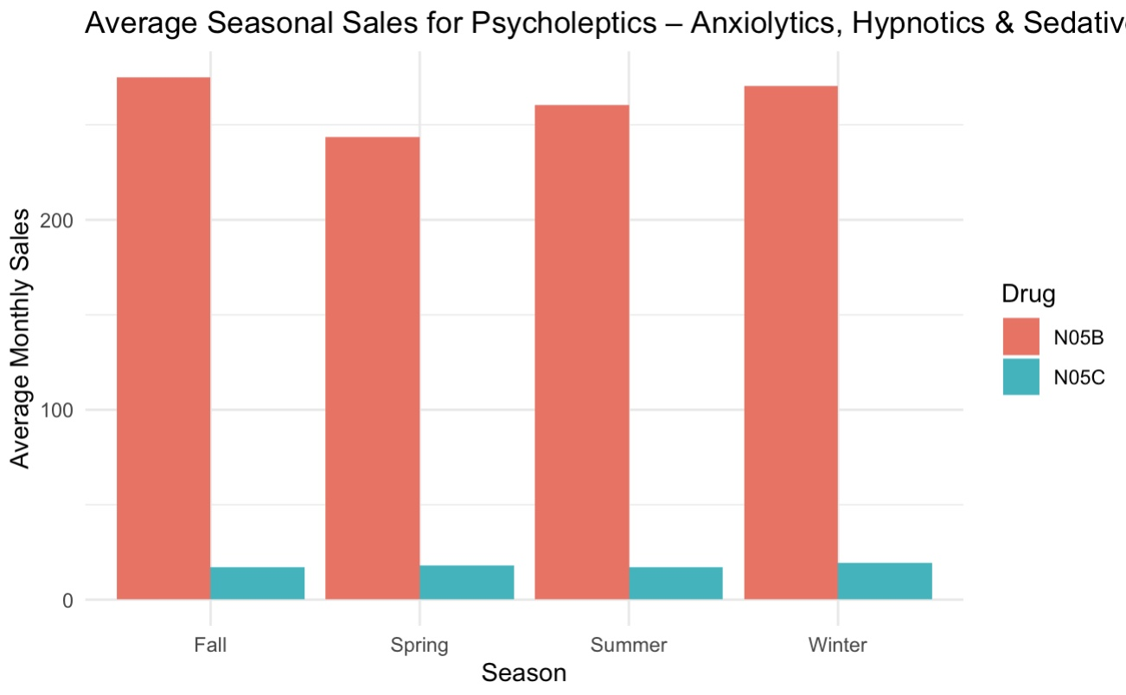
Psycholeptics
(N05B, N05C)
Average Monthly sales of these drugs — grouped by Season.
Trends remain steady throughout the year – on average.
N05B — Anxiety / Stress does increase in winter.
N05C — Sleep fluctuates with consistent but lower usage year-round.
Fig. 11: Seasonal Trends — Psycholeptics

Slide 16
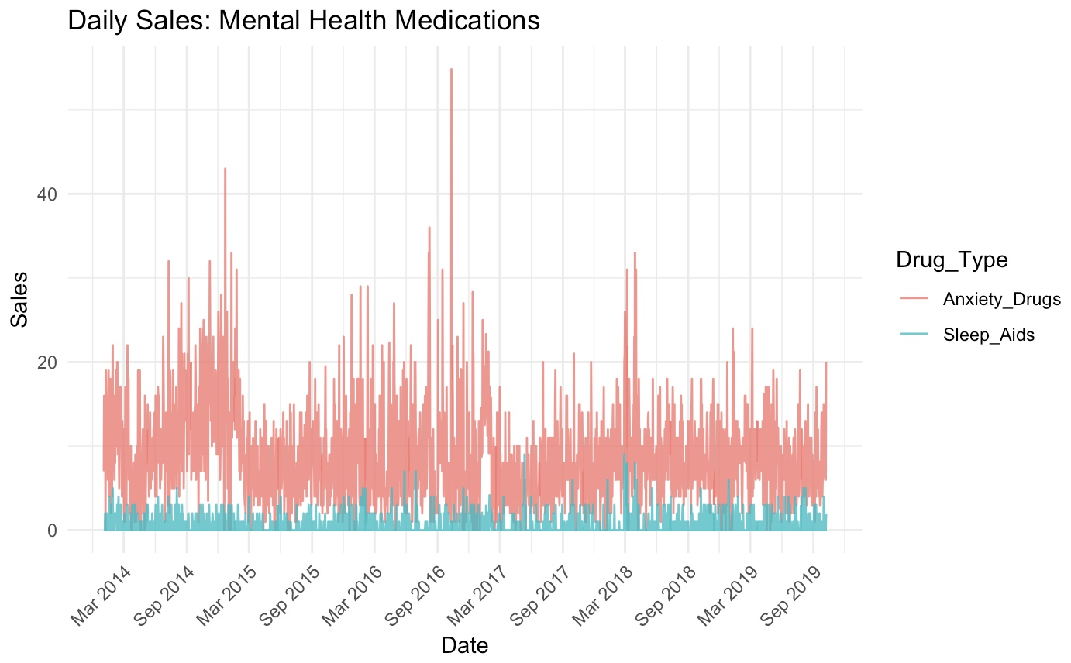
Mental Health Medication Usage Over Time
For long term patters — sales trends for full data set period
N05B — Anxiety / Stress — has spikes in mid-to-late 2014 and 2016, then again around 2018, which could be a point to look further into — to (potentially) find correlation / causation from external stressors or political events.
N05C — can be seen steadily increasing throughout the years with a similar spike around 2018.
Fig. 12: Overall Trends — Psycholeptics

Slide 17
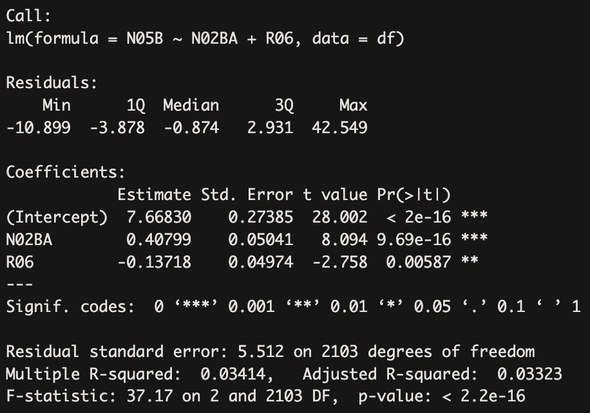
Anxiety Medications Regression Analysis
N02BA and N05B sales are positively correlated.
  Possibly because both are used more during cold/flu seasons (pain + anxiety).
R06 and N05B have a negative correlation.
  Could suggest that when allergy meds are in higher use, anxiety meds slightly drop — perhaps seasonal inverse usage or different patient groups.
Fig. 19: Regression Matrix - Psych Meds

Slide 18
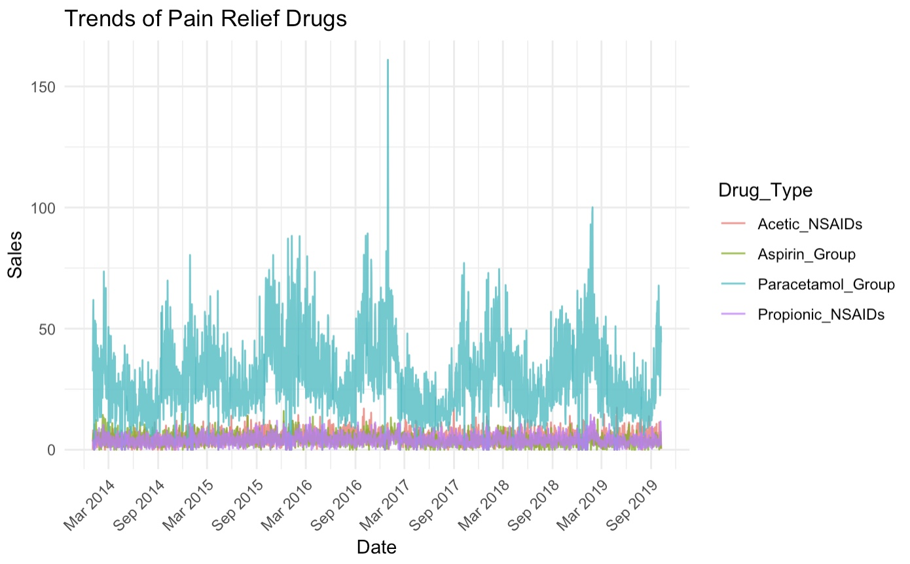
Trends of Pain Relief Drugs
1. Paracetamol (cyan line) dominates sales:
It is consistently the highest-selling drug group over the entire period.
Sales show seasonal spikes (e.g., visible in early 2015, 2016, 2017, and late 2018), likely during cold/flu seasons or other viral outbreaks.
One large spike in early 2017 likely reflects a significant demand event — possibly due to a widespread illness or policy change.
2. NSAIDs (Acetic & Propionic) and Aspirin_Group have:
Lower but steady usage over time.
No major upward or downward trend — usage remains fairly stable.
These lines hover around a baseline, showing less seasonal variation than paracetamol.
3. No major structural shifts over time:
No medication shows a dramatic upward or downward long-term trend.
Interpretation / Insights:
Paracetamol sales show short-term bursts, while the others remain flat with minor fluctuations.
Paracetamol appears to be the first-line pain/fever remedy for the population — likely due to OTC availability and broad usage.
Spikes in Paracetamol_Group align with expected flu seasons (winter to early spring).
NSAIDs and Aspirin may be more commonly used for chronic or inflammatory conditions, leading to steady, non-seasonal patterns.
Fig. 13: Overall Trends — Pain Medications

Slide 19
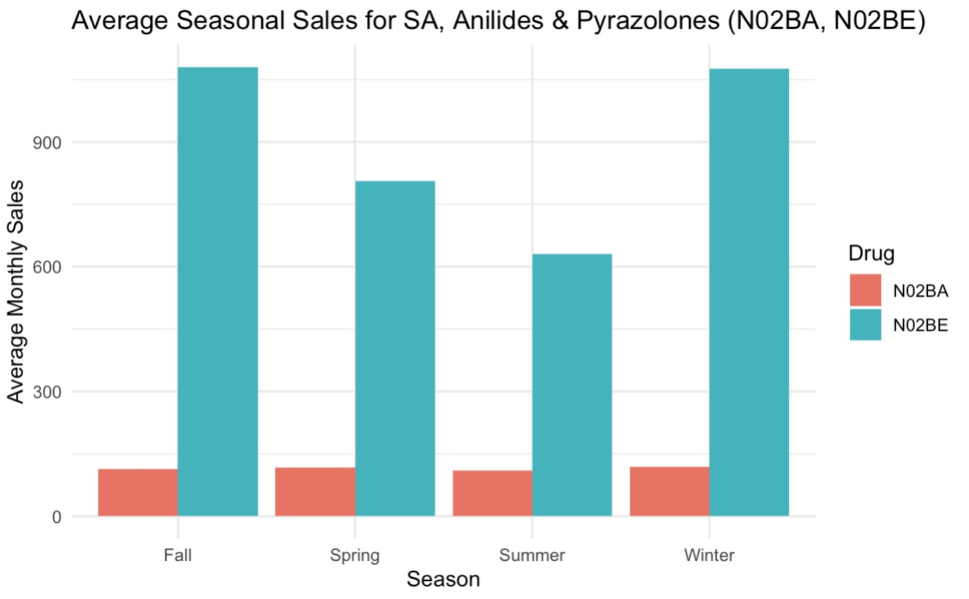
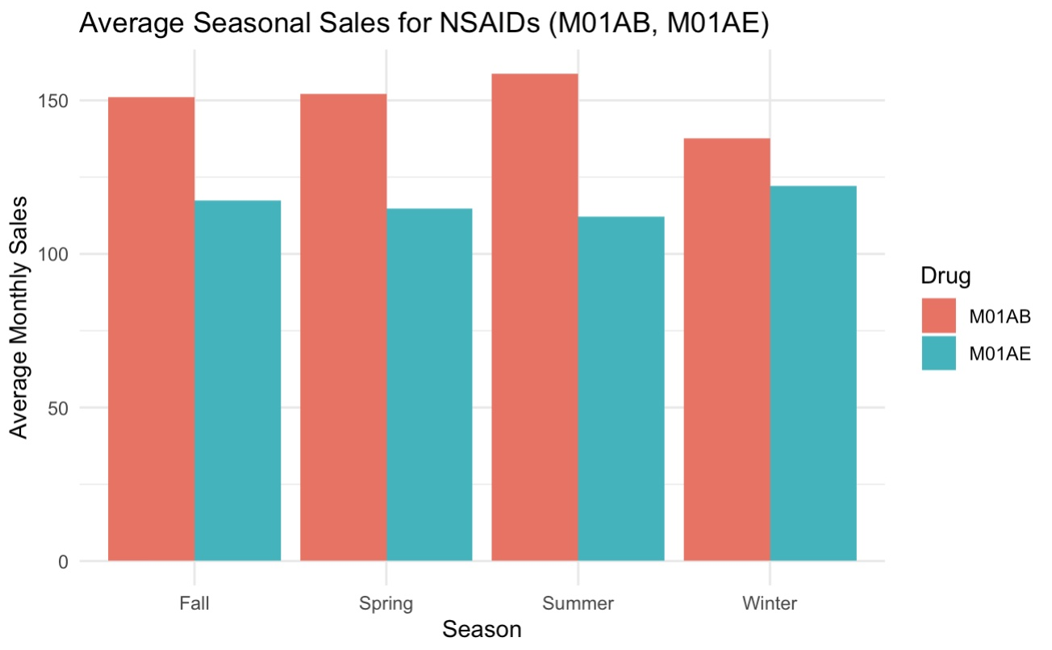
Pain Relief / Anti-Inflammatories
Fig. 14: Seasonal Trends — Pain Medications
M01AB — NSAIDs
Steady increase Fall → Spring → Summer with a notable drop in Winter.
M01AE — Ibuprofen / Naproxen
Slight increases in Fall/Winter — could suggest correlation to cold/flu season.
N02BA — Aspirin
Extreme jumps between Spring / Summer to Fall /Winter. Overall one of the best selling drugs.
N02BE — Acetaminophin
Notably lower sales than its counterpart (Aspirin) with no notable seasonal trends.
Fig. 15: Seasonal Trends — NSAIDs

Slide 20
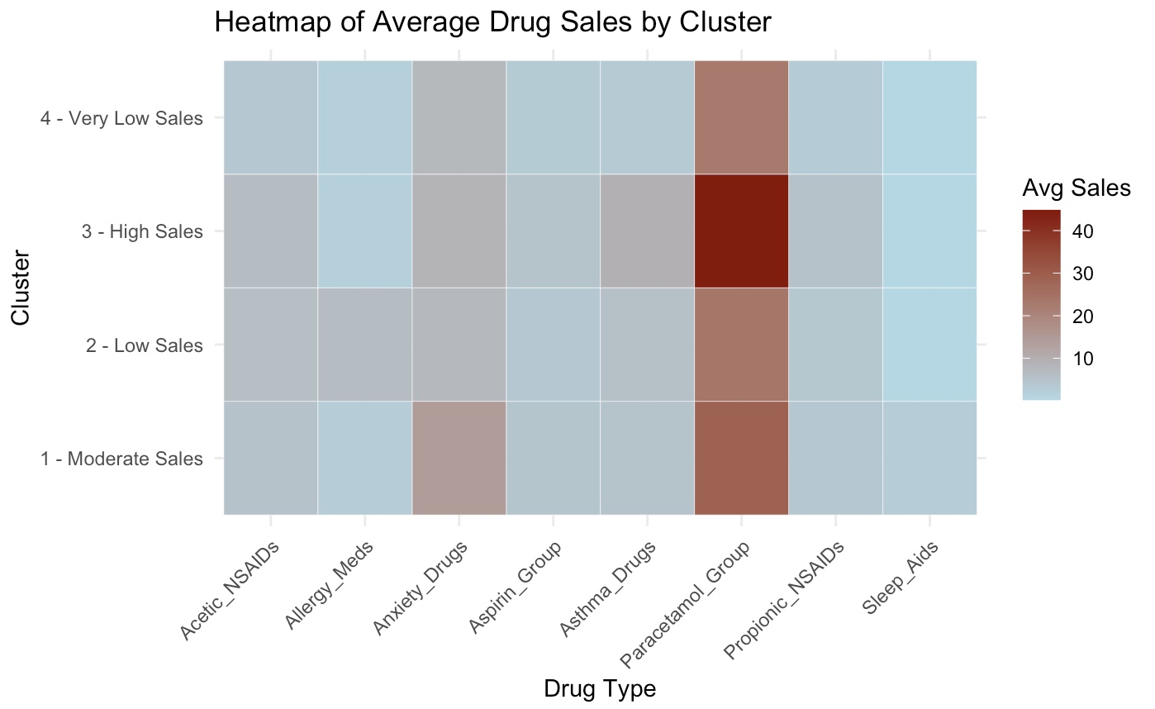
Heatmap of Average Drug
Sales by Cluster
The heatmap reveals distinct usage patterns across drug categories segmented by sales intensity clusters:
**Cluster 3 – High Sales**
This cluster shows the highest average drug sales, with a strong concentration in **Paracetamol_Group**. This pattern suggests flu or cold season spikes, likely during winter months. **Asthma_Drugs** and **Anxiety_Drugs** also show moderate elevation, possibly due to increased respiratory stress during colder seasons.
**Cluster 1 – Moderate Sales**
Drug usage is more balanced in this cluster. **Anxiety_Drugs** stand out with higher average values compared to other clusters, potentially indicating general stress-related or chronic mental health demand. **Paracetamol_Group** also remains elevated, though not as intense as in Cluster 3.
**Cluster 2 – Low Sales**
Sales levels drop for all drugs, though **Paracetamol_Group** maintains a modest presence. This cluster likely reflects regular days without major illness surges or seasonal effects.
**Cluster 4 – Very Low Sales**
This cluster exhibits the lowest drug sales across all categories, suggesting minimal demand. These may correspond to weekends, holidays, or summer periods when illness and medication use typically decline.
**Key Insight:**
Paracetamol dominates high-sales clusters, supporting its role as a first-line response for common illnesses. Anxiety and sleep medications peak during moderate usage periods, reflecting steady, non-seasonal demand. NSAID groups show consistent but low variation across clusters, implying their use is less tied to seasonal illness patterns.
Fig. 16: Heatmap

Slide 21
Challenges & Limitations
Dataset constraints
Generalizability
Time limitations for advanced modeling

Slide 22
Future Expansions
Predictive modeling
Use of external variables
Cross-referencing with regional or real-world drug use trends

Slide 23
Appendices
Figure Number Index
Fig. 1: Overview of the Data | Fig. 10: ARIMA Trend Difference Analysis
Fig. 2: ATC Drug Categories | Fig. 11: Seasonal Trends — Psycholeptics
Fig. 3: Seasonal Sales Trends — Respiratory / Allergy | Fig. 12: Overall Trends — Psycholeptics
Fig. 4: Seasonal Sales Trends II — Respiratory / Allergy | Fig. 13: Overall Trends — Pain Medications
Fig. 5: Cluster Averages | Fig. 14: Seasonal Trends — Pain Medications
Fig. 6: Holt-Winters Filtering | Fig. 15: Seasonal Trends — NSAIDs
Fig. 7: Holt-Winters Prediction | Fig. 16: Heatmap
Fig. 8: ARIMA Analysis | Fig. 17: Cluster Map
Fig. 9: ACF Time Series Analysis | Fig. 18: HoltWinters Model Comparison
 | Fig. 19: Regression Matrix - Psych Meds
Key R code snippets (formatted and commented)
Extended plots if needed
ATC code descriptions

Slide 24
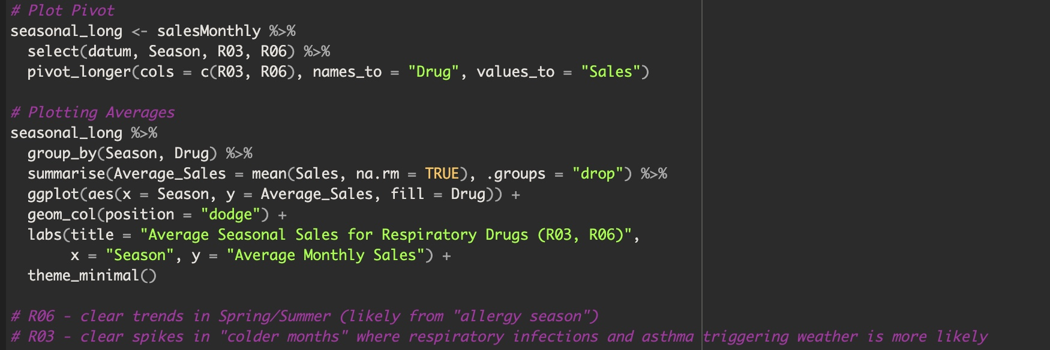
Appendices
Figure 3. Seasonal Sales Trends — Respiratory / Allergy

Slide 25
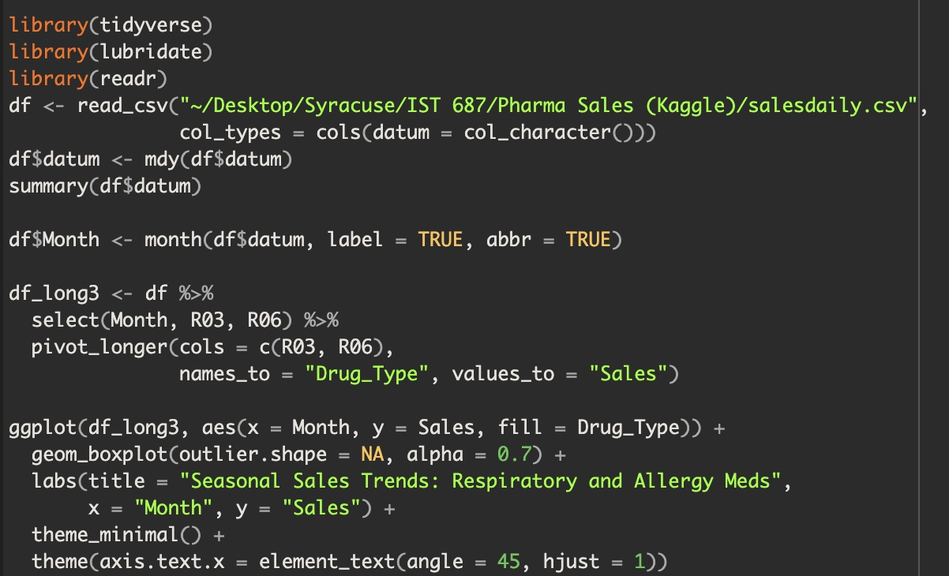
Appendices
Fig. 4: Seasonal Sales Trends II — Respiratory / Allergy

Slide 26
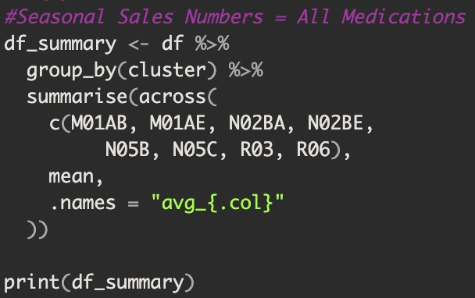
Appendices
Fig. 5: Cluster Averages

Slide 27
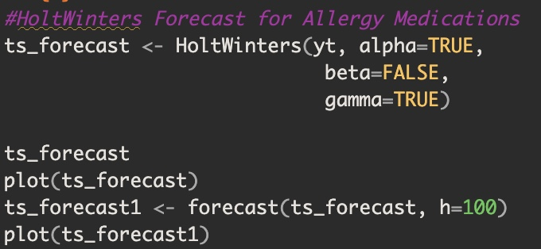
Appendices
Fig. 6: Holt-Winters Filtering / Fig. 7: Holt-Winters Prediction

Slide 28
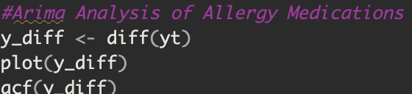
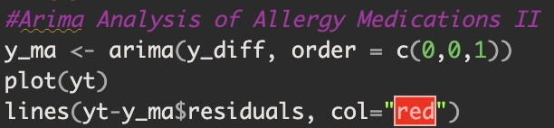
Appendices
Fig. 8: ARIMA Analysis / Fig. 9: ACF Time Series Analysis / Fig. 10: ARIMA Trend Difference Analysis

Slide 29
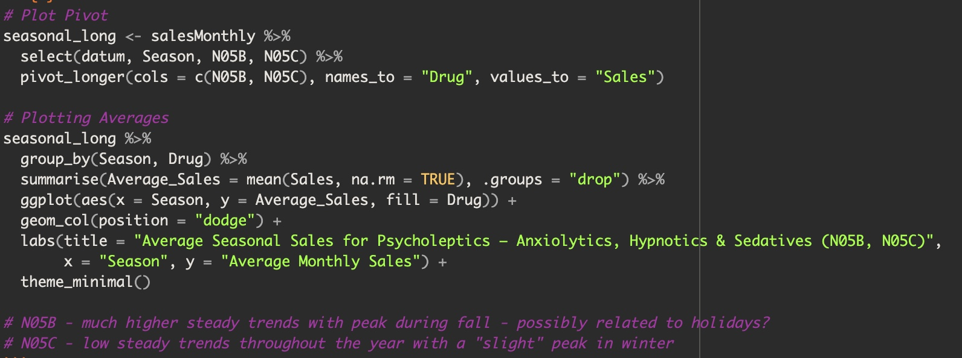
Appendices
Fig. 11: Seasonal Trends — Psycholeptics

Slide 30
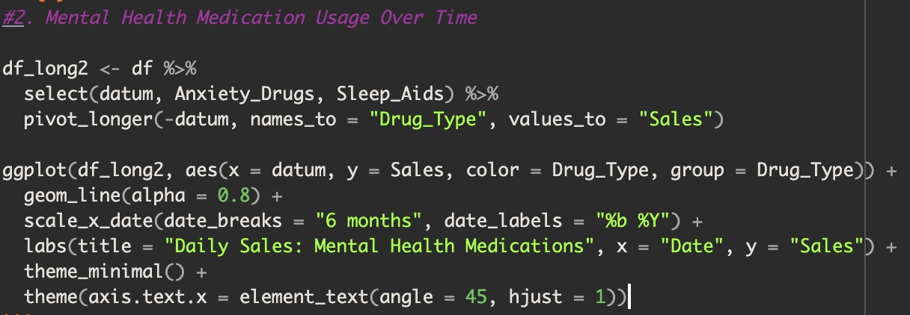
Appendices
Fig. 12: Overall Trends — Psycholeptics

Slide 31
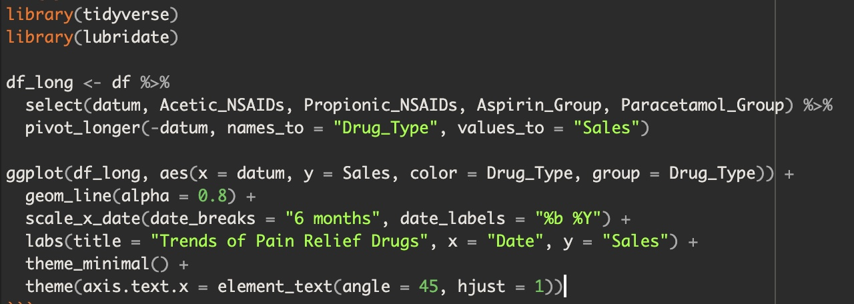
Appendices
Fig. 13: Overall Trends — Pain Medications

Slide 32
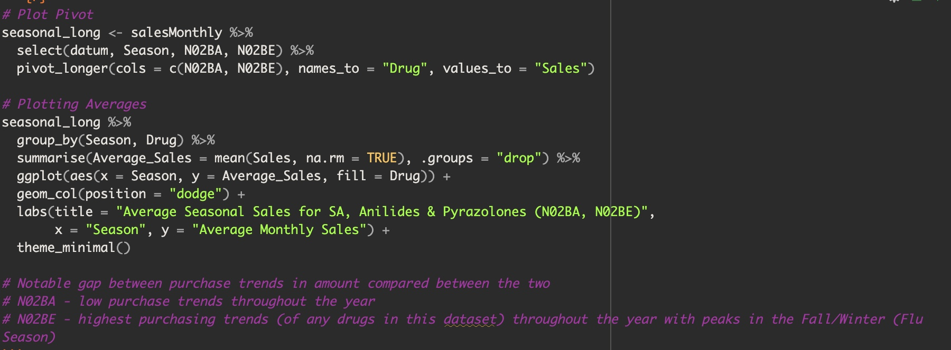
Appendices
Fig. 14: Seasonal Trends — Pain Medications

Slide 33
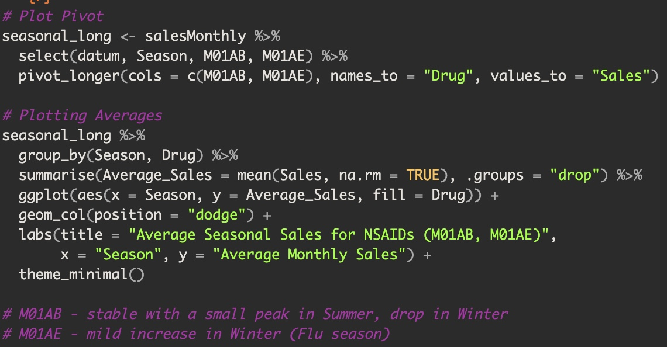
Appendices
Fig. 15: Seasonal Trends — NSAIDs

Slide 34
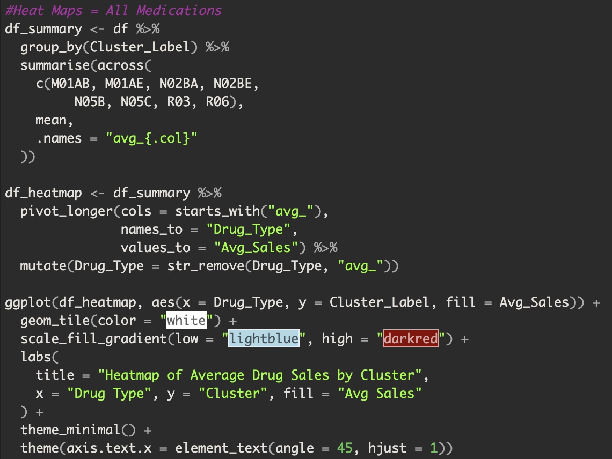
Appendices
Fig. 16: Heatmap

Slide 35
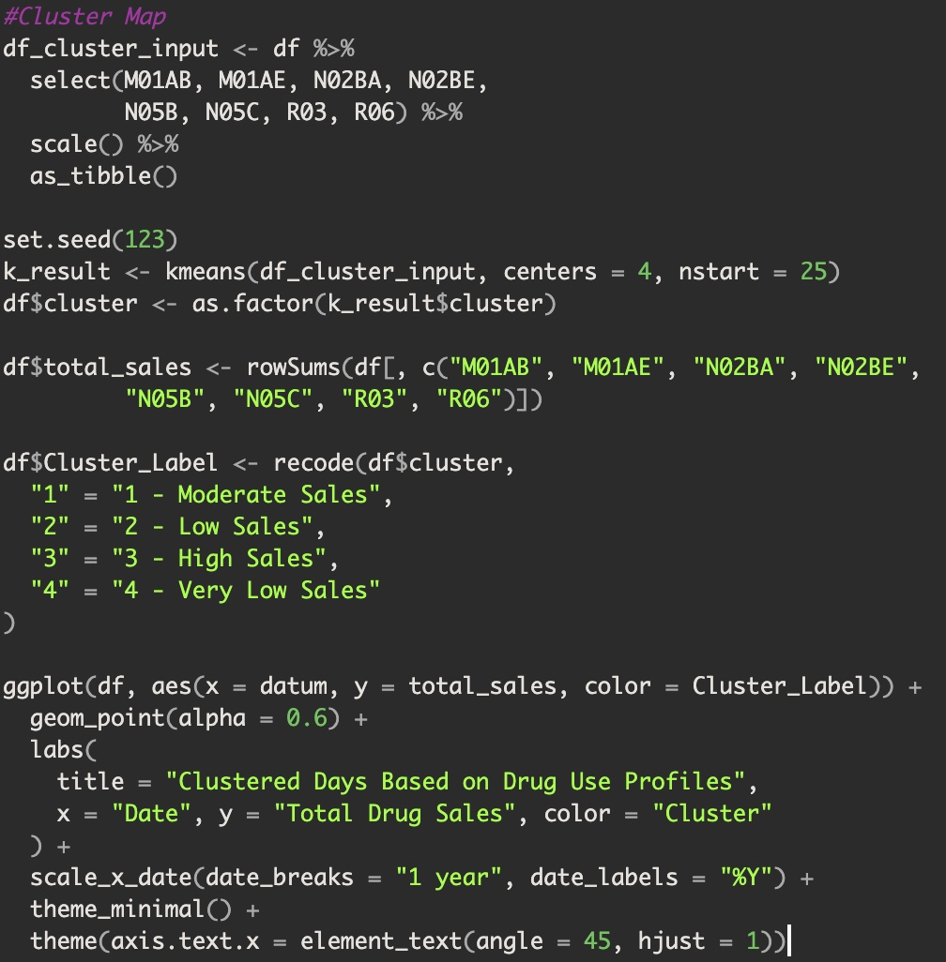
Appendices
Fig. 17: Cluster Map

Slide 36
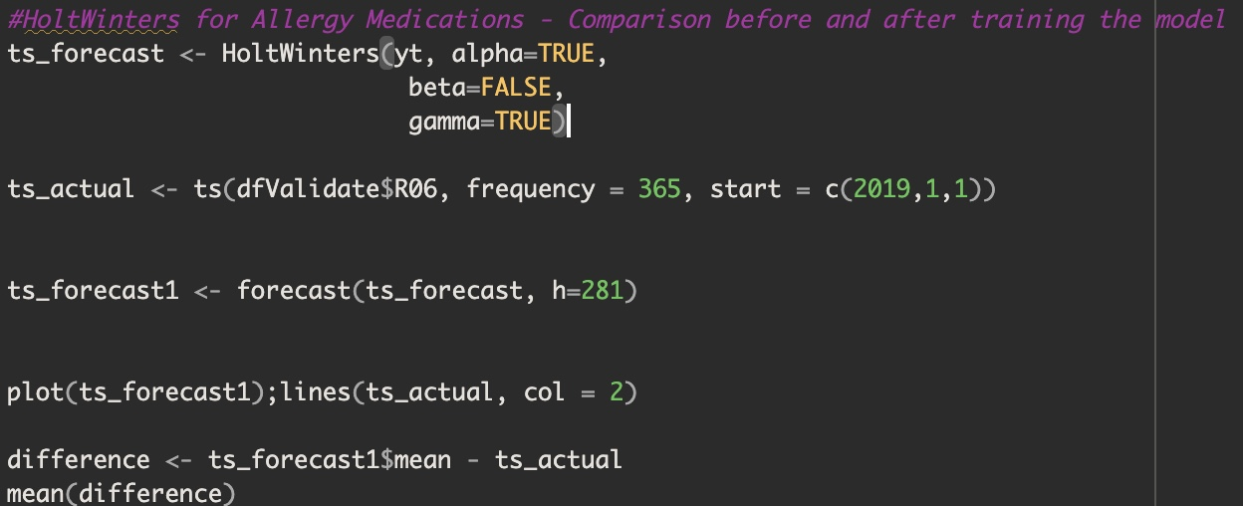
Appendices
Fig. 18: HoltWinters Model Comparison

Slide 37
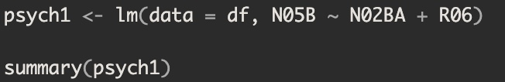
Appendices
Fig. 19: Regression Matrix - Psych Meds

